Slide 1
Interview Behaviour
Should do during interview | Should not do during interview | Could do before interview

Slide 2
Interview Behaviour
Should do during interview | Should not do during interview | Could do before interview
Speak clearly | Answer briefly | Dress smartly
Shake hands firmly | Avoid eye contact | Send references
Show enthusiasm | Look angry | Arrive on time
Give full answers | Look bored | Do some research
Ask questions | Speak very quietly | Be prepared
Make eye contact | Interrupt interviewer | Sleep well
Listen carefully | Check your phone

Slide 3
Introducing an Opinion
Extract 1
S: I’ve studied English for many years and spent time in Britain, but that was a few years ago. So for me the most important thing is to just refresh… and try to remember my English and practise speaking and listening.

Slide 4
Introducing an Opinion
Extract 2
I: OK. And you enjoyed it?
A: Yes.
I: What aspect, what part did you enjoy, would you say?
A: I suppose I’d have to say I like the games best.
I: And any problems?
A: Um, no.
I: What about different ages? We often find that different ages together can be difficult.
A: It depends. In my opinion, you can usually get the older children to help the younger ones.
Extract 3
S: If I’m accepted, I saw that there are, that it’s possible to take some courses online. I: That’s right. S: So I wouldn’t need to attend classes? I: Not for online courses. But… well, one thing I’d like to say is that the online courses are, in many ways, more difficult that face-to-face courses.

Slide 5
Introducing an Opinion
Extract 2
I: OK. And you enjoyed it?
A: Yes.
I: What aspect, what part did you enjoy, would you say?
A: I suppose I’d have to say I like the games best.
I: And any problems?
A: Um, no.
I: What about different ages? We often find that different ages together can be difficult.
A: It depends. In my opinion, you can usually get the older children to help the younger ones.
Extract 3
S: If I’m accepted, I saw that there are, that it’s possible to take some courses online. I: That’s right. S: So I wouldn’t need to attend classes? I: Not for online courses. But… well, one thing I’d like to say is that the online courses are, in many ways, more difficult that face-to-face courses.

Slide 6
Introducing an Opinion
For me, the most important thing is…
I’d have to say…
In my opinion….
One thing I’d like to say…

Slide 7
Introducing a Question
I do have a query…
Could I ask a question?
There are a couple of things I’d like to ask…
Can I ask you about that?

Slide 8
Introducing Opinions & Questions
For me, the most important thing is…
Could I ask a question?
There are a couple of things I’d like to ask…
Can I ask you about that?
I’d have to say…
In my opinion….
One thing I’d like to say…
I do have a query…

Slide 9
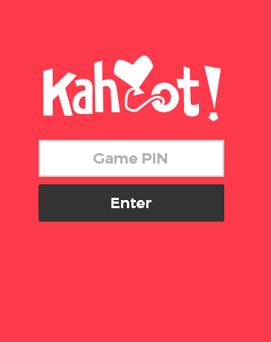
Quiz time!
kahoot.it
https://play.kahoot.it/#/?quizId=6bed5157-7149-4dd8-977a-b6e5e75a4816

Slide 10
Natural two-word responses
Of course
That’s right
I see
No problem
Go ahead
Not really
That’s fine
Sort of
Not necessarily
That’s true

